Slide 1
INTRODUCTION TO COMPUTING
Course Code: CCINCOM/L
Introduction to Data Science
Elizer Ponio Jr.
Faculty
Department of Computer Science
College of Computing and Information Technologies (CCIT)
National University
Joseph Marvin R. Imperial
DATA SCIENCE 1
NU College of Computing and Information Technologies
COURSE CODE: CCDATSC1L

Slide 2
Goals
What is Data Science?
What is a Data Scientist?
The Data in Data Science
Introduction to the Science of Data
Joseph Marvin R. Imperial
DATA SCIENCE 1
NU College of Computing and Information Technologies
COURSE CODE: CCDATSC1L

Slide 3
What is Data Science?
Introduction to the Science of Data
Joseph Marvin R. Imperial
DATA SCIENCE 1
NU College of Computing and Information Technologies
COURSE CODE: CCDATSC1L

Slide 4
Definitions
“It’s what a data-scientist does.” – circular
“Machine learning/data mining/statistics.” – too narrow
“Collecting, manipulating, and analyzing data in order to extracting value from it.”
Solve business problems using data.
”[…] almost everytging that has something to do with data: Collecting, analyzing, modeling… yet the most important important part of its applications-– all sorts applications
Simple Definition: “Data Science is the extraction of knowledge from data, which is a continuation of the field of data mining and predictive analytics.”
NIST Big Data Working Group: “Data Science is the empirical synthesis of actionable knowledge from raw data through the complete data lifecycle process.”
Introduction to the Science of Data
Joseph Marvin R. Imperial
DATA SCIENCE 1
NU College of Computing and Information Technologies
COURSE CODE: CCDATSC1L

Slide 5
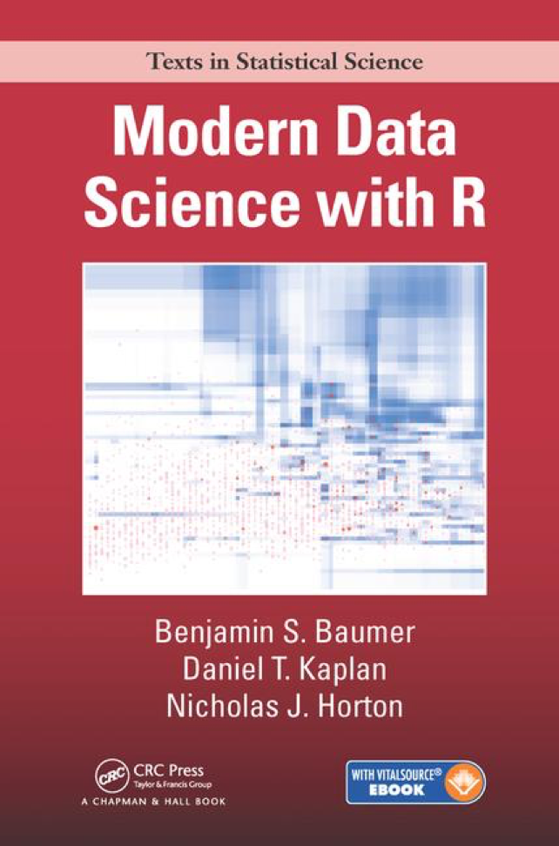
Introduction to the Science of Data
“We hold a broad view
of data science– we see it as the science of extracting meaningful information from data.”
Joseph Marvin R. Imperial
DATA SCIENCE 1
NU College of Computing and Information Technologies
COURSE CODE: CCDATSC1L

Slide 6
Data Science is…
Actively creating a question to investigate with data.
Connecting that question with the collection of appropriate data and the application of appropriate methods, algorithms, computational tools or languages in a data analysis.
Communicating and making decisions based on new or already established knowledge derived from the data and data analysis.
Hicks and Peng (2019) arXiv (https://arxiv.org/abs/1903.07639)
Introduction to the Science of Data
Joseph Marvin R. Imperial
DATA SCIENCE 1
NU College of Computing and Information Technologies
COURSE CODE: CCDATSC1L

Slide 7



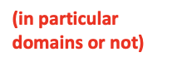

Data Science is…
Actively creating a question to investigate with data.
Connecting that question with the collection of appropriate data and the application of appropriate methods, algorithms, computational tools or languages in a data analysis.
Communicating and making decisions based on new or already established knowledge derived from the data and data analysis.
Hicks and Peng (2019) arXiv (https://arxiv.org/abs/1903.07639)
Introduction to the Science of Data
Joseph Marvin R. Imperial
DATA SCIENCE 1
NU College of Computing and Information Technologies
COURSE CODE: CCDATSC1L

Slide 8
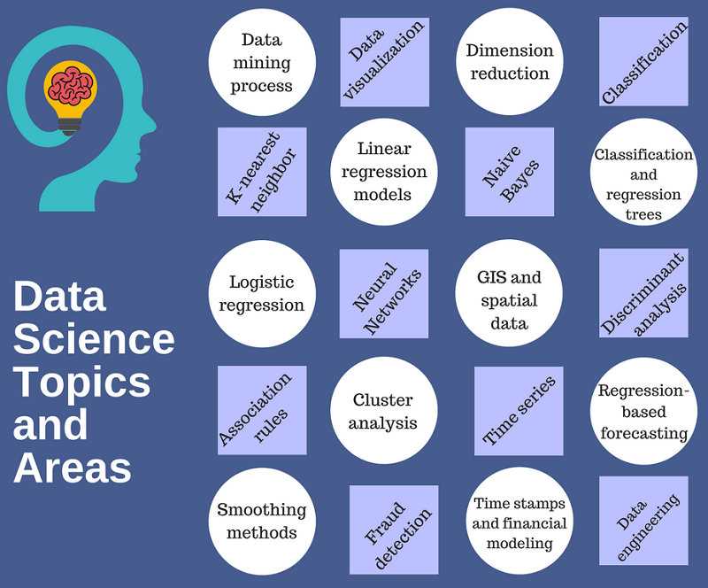
Spectrum
Introduction to the Science of Data
Joseph Marvin R. Imperial
DATA SCIENCE 1
NU College of Computing and Information Technologies
COURSE CODE: CCDATSC1L

Slide 9
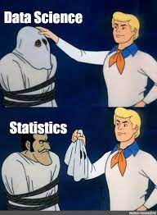
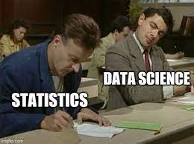
Data Science vs Statistics
Introduction to the Science of Data
Joseph Marvin R. Imperial
DATA SCIENCE 1
NU College of Computing and Information Technologies
COURSE CODE: CCDATSC1L

Slide 10
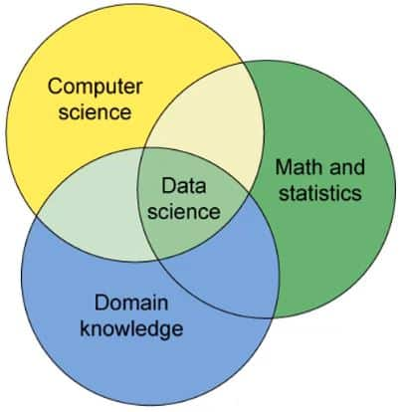
Data Science vs Statistics
Data science is often understood as a broader, task-driven and computationally-oriented version of statistics (Carmichael and Marron, 2018).
Introduction to the Science of Data
Joseph Marvin R. Imperial
DATA SCIENCE 1
NU College of Computing and Information Technologies
COURSE CODE: CCDATSC1L

Slide 11
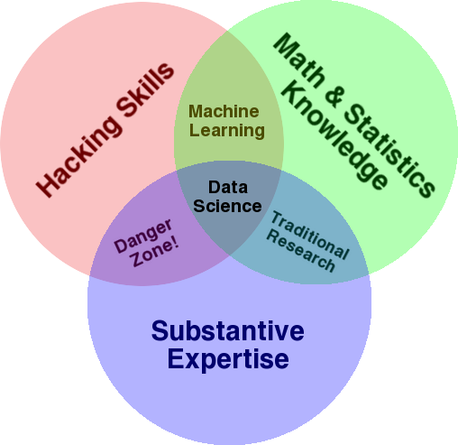
Drew Conway’s Venn diagram of Data Science
Introduction to the Science of Data
Joseph Marvin R. Imperial
DATA SCIENCE 1
NU College of Computing and Information Technologies
COURSE CODE: CCDATSC1L

Slide 12
The Hype
There’s huge and growing demand especially in business.
Because of the hype, everyone wants to “own” data science!
– many of them are just selling their stuff with a new label.
Introduction to the Science of Data
Joseph Marvin R. Imperial
DATA SCIENCE 1
NU College of Computing and Information Technologies
COURSE CODE: CCDATSC1L

Slide 13
Who is a Data Scientist?
Introduction to the Science of Data
Joseph Marvin R. Imperial
DATA SCIENCE 1
NU College of Computing and Information Technologies
COURSE CODE: CCDATSC1L

Slide 14
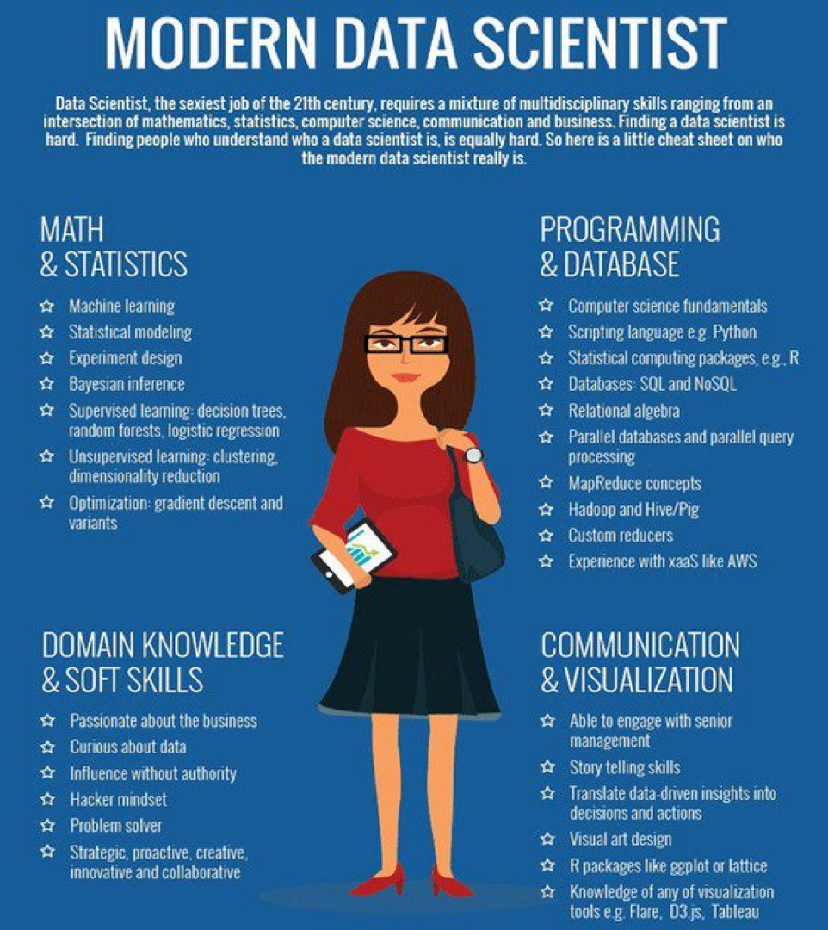
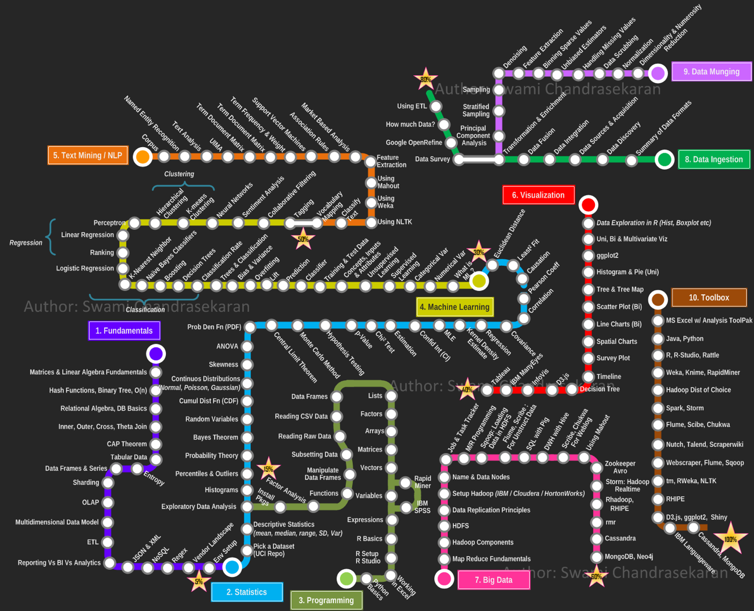
Introduction to the Science of Data
Joseph Marvin R. Imperial
DATA SCIENCE 1
NU College of Computing and Information Technologies
COURSE CODE: CCDATSC1L

Slide 15
A Data Scientist is someone who
– can understand the background domain
– can design solutions that produce added value to the organization
– can implement the solutions efficiently
– can communicate the findings clearly (important!)
– Sexiest job of the 21st century by Harvard Business Review
Data Scientist is a practitioner with sufficient expertise in software engineering, statistics, machine learning, and the application domain.
Introduction to the Science of Data
Joseph Marvin R. Imperial
DATA SCIENCE 1
NU College of Computing and Information Technologies
COURSE CODE: CCDATSC1L

Slide 16
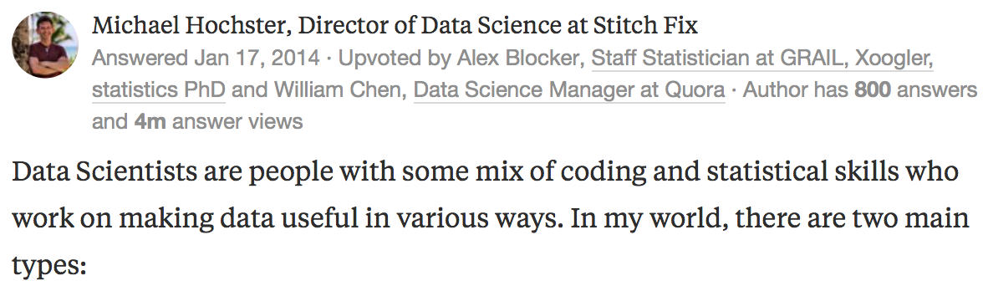
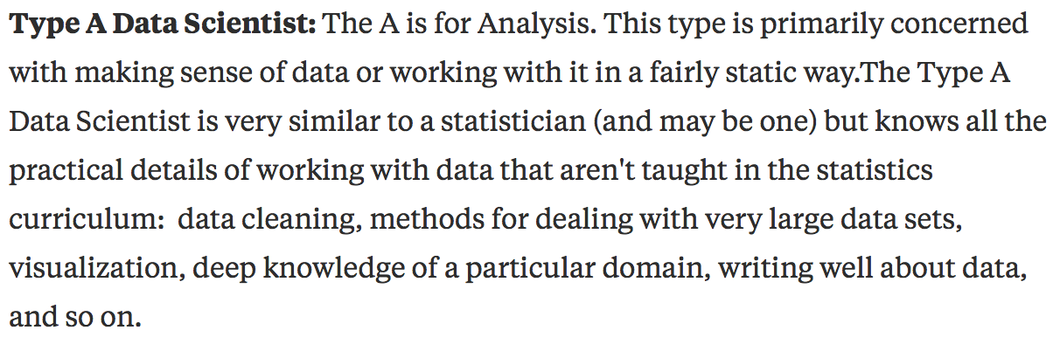
“Data scientists” defined by Michael Hochster
Introduction to the Science of Data
https://www.quora.com/What-is-data-science
Joseph Marvin R. Imperial
DATA SCIENCE 1
NU College of Computing and Information Technologies
COURSE CODE: CCDATSC1L

Slide 17
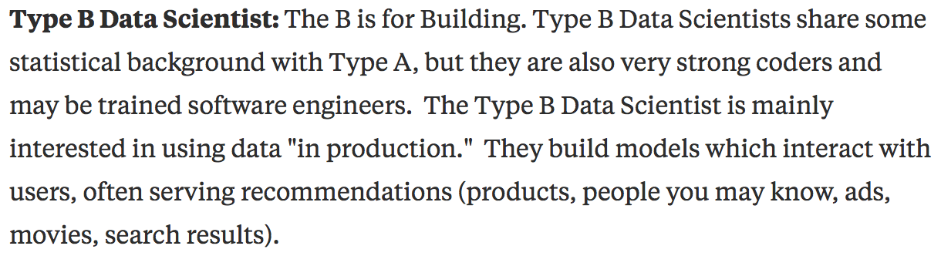
“Data scientists” defined by Michael Hochster
Introduction to the Science of Data
https://www.quora.com/What-is-data-science
Joseph Marvin R. Imperial
DATA SCIENCE 1
NU College of Computing and Information Technologies
COURSE CODE: CCDATSC1L

Slide 18
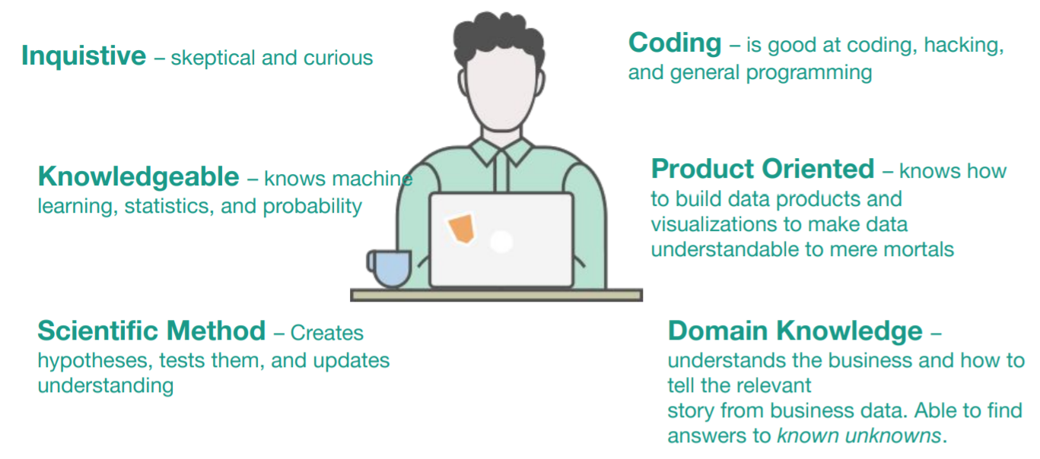
We will focus on
“Type A” data scientists - Individuals who process and interpret data as it pertains to answering real-world questions.
Introduction to the Science of Data
Joseph Marvin R. Imperial
DATA SCIENCE 1
NU College of Computing and Information Technologies
COURSE CODE: CCDATSC1L

Slide 19
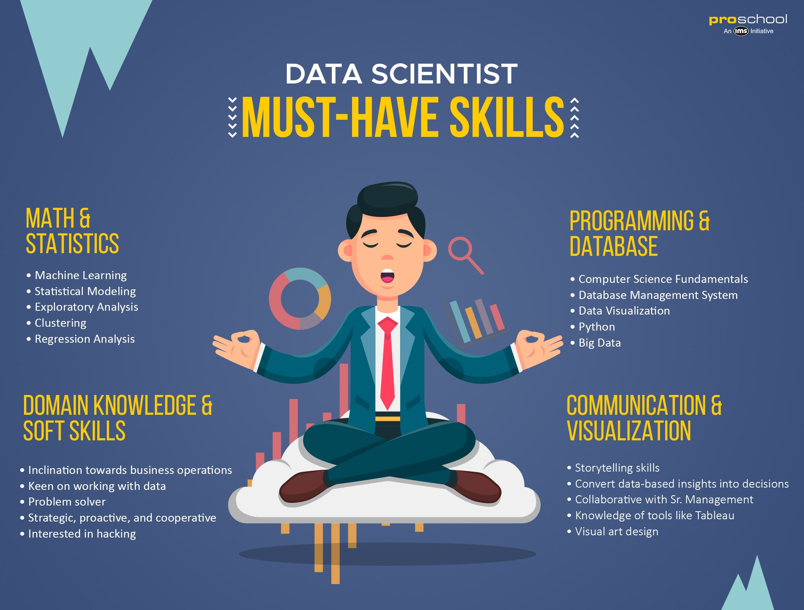
We will focus on
“Type A” data scientists - Individuals who process and interpret data as it pertains to answering real-world questions.
Introduction to the Science of Data
Joseph Marvin R. Imperial
DATA SCIENCE 1
NU College of Computing and Information Technologies
COURSE CODE: CCDATSC1L

Slide 20
Computer science Math Statistics Machine learning Domain expertise Communication and presentation skills Data visualization
Profile of a Data Scientist
Introduction to the Science of Data
Nobody is an expert in everything! No one person can be the perfect data scientist. So we need teams!
Joseph Marvin R. Imperial
DATA SCIENCE 1
NU College of Computing and Information Technologies
COURSE CODE: CCDATSC1L

Slide 21
The Data in Data Science
Introduction to the Science of Data
Joseph Marvin R. Imperial
DATA SCIENCE 1
NU College of Computing and Information Technologies
COURSE CODE: CCDATSC1L

Slide 22
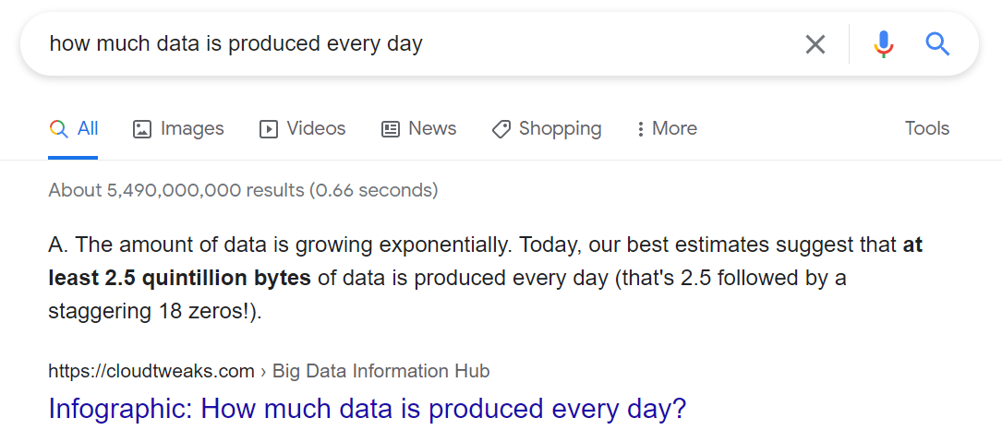
Data
A crucial part of the rise of data science is the steep increase in the amount and availability of data.
Literally everyone produces data every single second.
Every search on Google, every keystroke, every click of your mouse contributes to data being generated.
Introduction to the Science of Data
Joseph Marvin R. Imperial
DATA SCIENCE 1
NU College of Computing and Information Technologies
COURSE CODE: CCDATSC1L

Slide 23
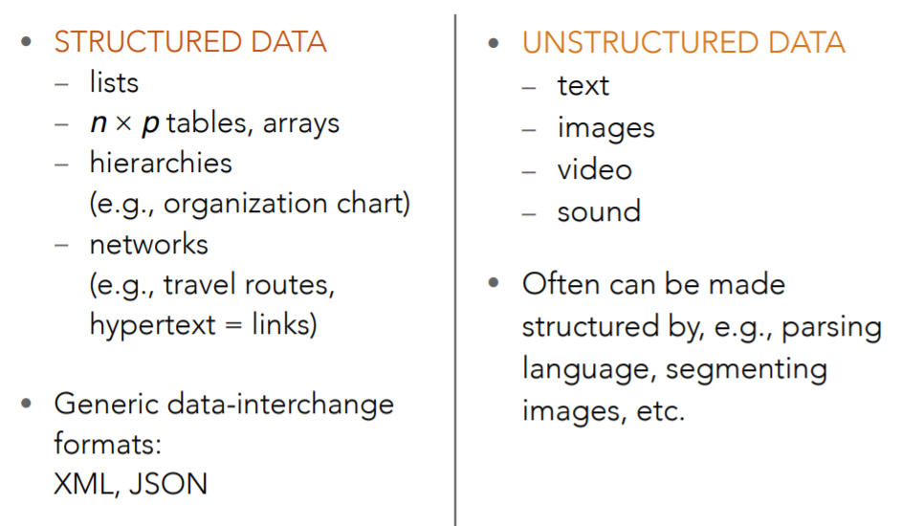
Kinds of Data
Introduction to the Science of Data
Joseph Marvin R. Imperial
DATA SCIENCE 1
NU College of Computing and Information Technologies
COURSE CODE: CCDATSC1L

Slide 24
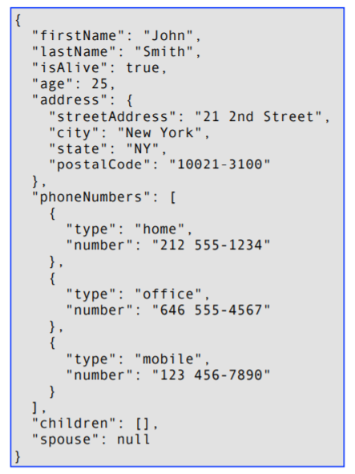
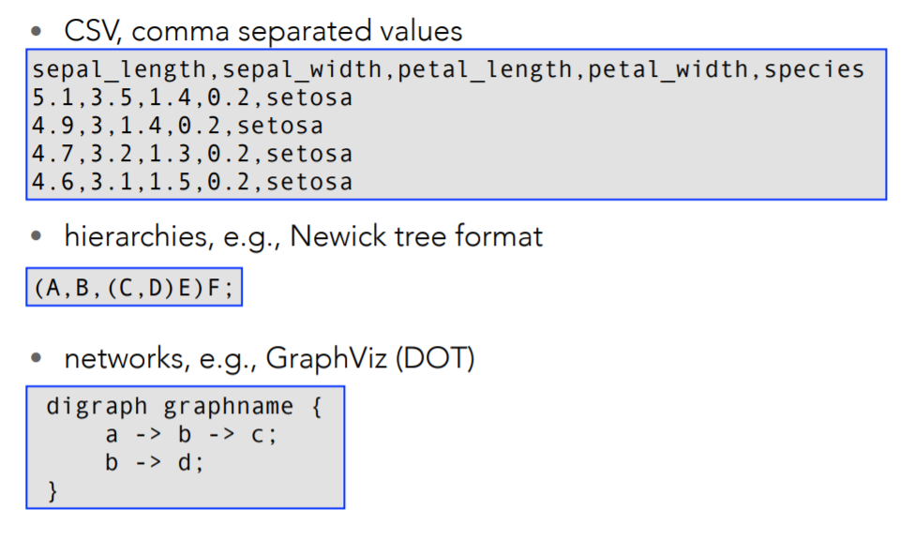
Structured Data
Introduction to the Science of Data
Joseph Marvin R. Imperial
DATA SCIENCE 1
NU College of Computing and Information Technologies
COURSE CODE: CCDATSC1L

Slide 25
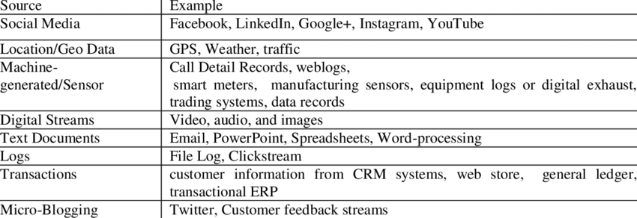
Unstructured Data
Introduction to the Science of Data
Joseph Marvin R. Imperial
DATA SCIENCE 1
NU College of Computing and Information Technologies
COURSE CODE: CCDATSC1L

Slide 26
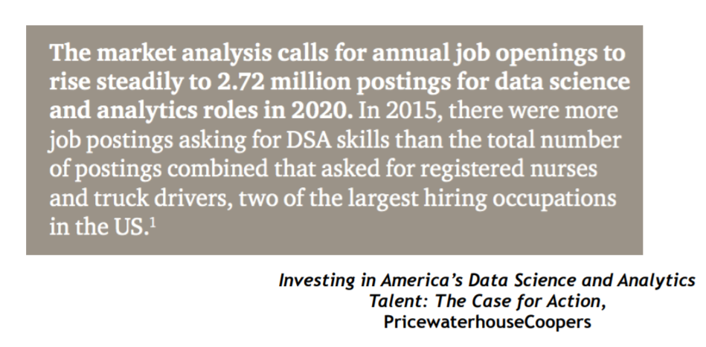
Demand for Data Science
Introduction to the Science of Data
Joseph Marvin R. Imperial
DATA SCIENCE 1
NU College of Computing and Information Technologies
COURSE CODE: CCDATSC1L

Slide 27
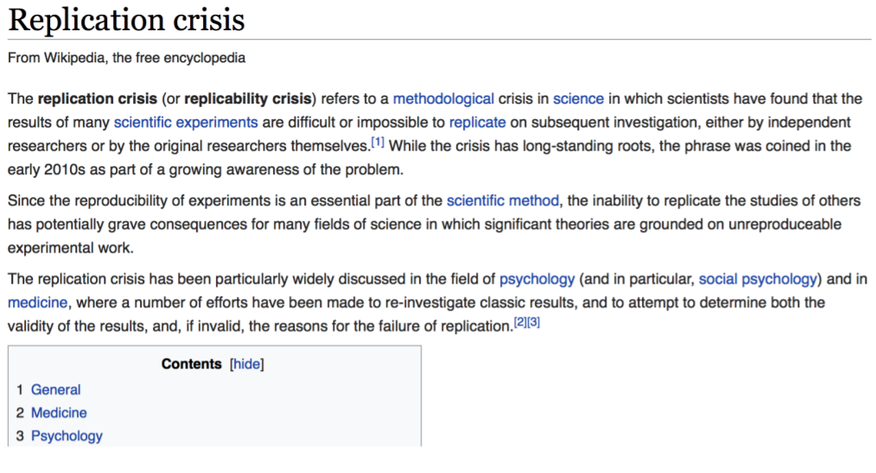
Demand for Data Science
Introduction to the Science of Data
Joseph Marvin R. Imperial
DATA SCIENCE 1
NU College of Computing and Information Technologies
COURSE CODE: CCDATSC1L

Slide 28
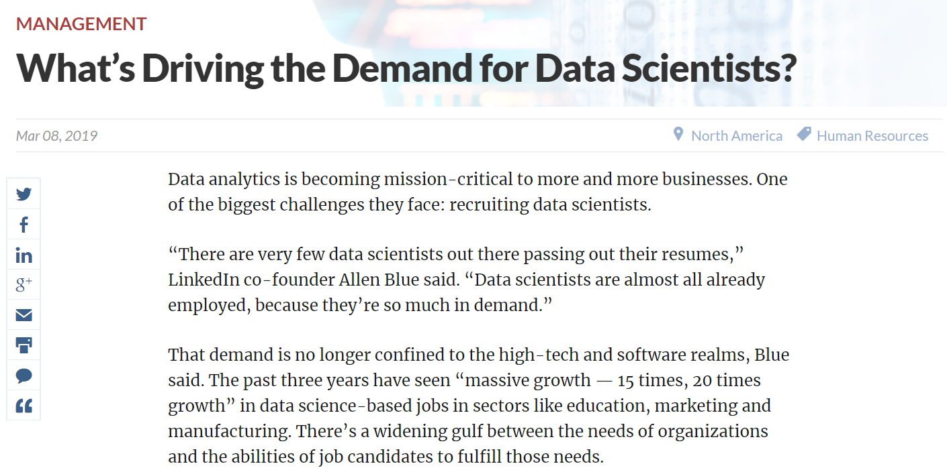
Demand for Data Science
Introduction to the Science of Data
Joseph Marvin R. Imperial
DATA SCIENCE 1
NU College of Computing and Information Technologies
COURSE CODE: CCDATSC1L

Slide 29
Real World Use Cases
AirBnB uses data science to help renters set their prices.
Aerosolve’s predictive model takes the optimal price for a rental based on its location, time of year, and a variety of other attributes.
Sports analytics.
Looking at all pitchers who had thrown more than 1,000 pitches, the team developed a model that considers current at-bat statistics, in-game situations, and generic pitching measures to predict the next pitch.
Defense and anti-terrorism.
Data science can be used to prevent illegal immigration, identify suspicious activities in crowded areas, predicting locations and movements of nuclear weapons in enemy countries, recognizing and tracking terrorists, detecting violence, flying drones, guiding missiles etc.
Space research.
Data science can be used to predict these solar flares in advance so that arrangements to minimize loss can be made.
Introduction to the Science of Data
Joseph Marvin R. Imperial
DATA SCIENCE 1
NU College of Computing and Information Technologies
COURSE CODE: CCDATSC1L

Slide 30

How data transformed the NBA
Introduction to the Science of Data
Joseph Marvin R. Imperial
DATA SCIENCE 1
NU College of Computing and Information Technologies
COURSE CODE: CCDATSC1L

Slide 31

How Astronomers Took The First Ever Image Of A Black Hole
Introduction to the Science of Data
Joseph Marvin R. Imperial
DATA SCIENCE 1
NU College of Computing and Information Technologies
COURSE CODE: CCDATSC1L

Slide 32

The Algorithm That Catches Serial Killers
Introduction to the Science of Data
Joseph Marvin R. Imperial
DATA SCIENCE 1
NU College of Computing and Information Technologies
COURSE CODE: CCDATSC1L

Slide 33
High Level Picture of Being a Data Scientist
A data scientist is someone who knows how to extract meaning from and interpret data, which requires both tools and methods from statistics and machine learning, as well as being human.
She spends a lot of time in the process of collecting, cleaning, and munging data, because data is never clean.
This process requires persistence, statistics, and software engineering skills—skills that are also necessary for understanding biases in the data, and for debugging logging output from code.
Joseph Marvin R. Imperial
DATA SCIENCE 1
NU College of Computing and Information Technologies
COURSE CODE: CCDATSC1L

Slide 34
High Level Picture of Being a Data Scientist
Once she gets the data into shape, a crucial part is exploratory data analysis, which combines visualization and data sense. She’ll find pat‐ terns, build models, and algorithms—some with the intention of understanding product usage and the overall health of the product, and others to serve as prototypes that ultimately get baked back into the product.
She may design experiments, and she is a critical part of data- driven decision making.
She’ll communicate with team members, engineers, and leadership in clear language and with data visualizations so that even if her colleagues are not immersed in the data themselves, they will understand the implications.
Joseph Marvin R. Imperial
DATA SCIENCE 1
NU College of Computing and Information Technologies
COURSE CODE: CCDATSC1L

Slide 35
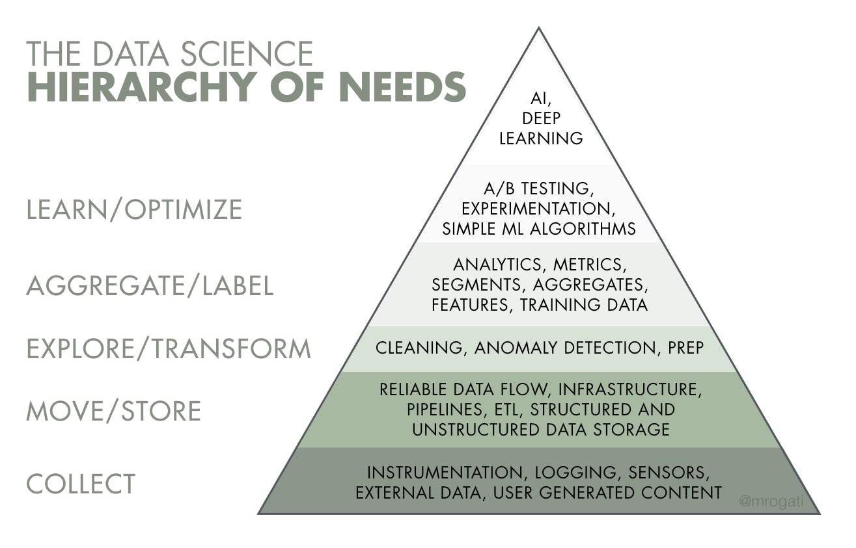
Joseph Marvin R. Imperial
DATA SCIENCE 1
NU College of Computing and Information Technologies
COURSE CODE: CCDATSC1L

Slide 36
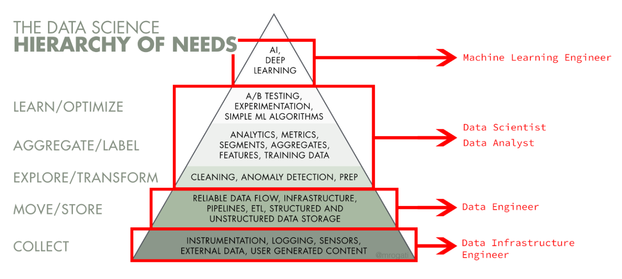
Joseph Marvin R. Imperial
DATA SCIENCE 1
NU College of Computing and Information Technologies
COURSE CODE: CCDATSC1L

Slide 37
References
University of Helsinki. Introduction to Data Science course.
Johns Hopkins University. Advanced Data Science course.
Introduction to the Science of Data
Joseph Marvin R. Imperial
DATA SCIENCE 1
NU College of Computing and Information Technologies
COURSE CODE: CCDATSC1L

